Slide 1



Psyliq- Employee Data Analysis Assessment
Aman Jha
(DATA ANALYST INTERN)

Slide 2
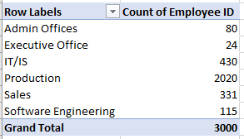
Can you create a pivot table to summarize the total number of employees in each department?

Slide 3
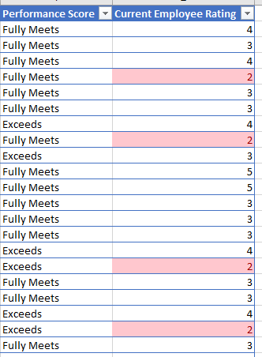
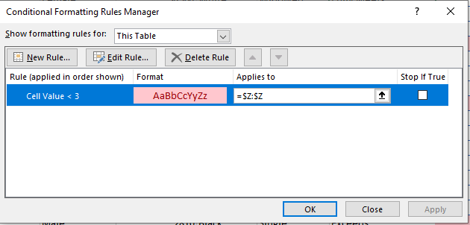
Apply conditional formatting to highlight employees with a "Performance Score“ below 3 in red.

Slide 4

Calculate the average "Satisfaction Score" for male and female employees separately using a pivot table.

Slide 5
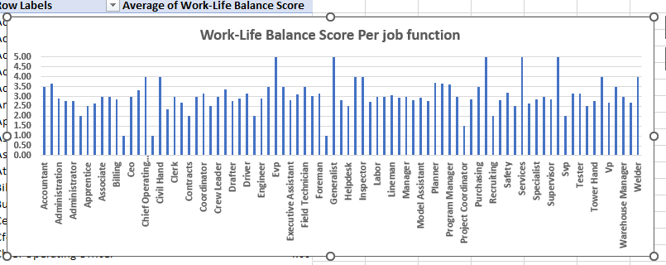
Create a chart to visualize the distribution of "Work-Life Balance Score" for different job functions.

Slide 6
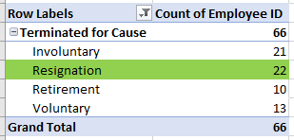
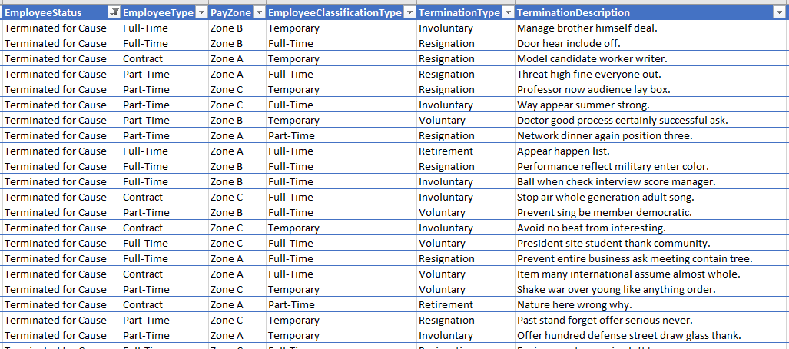
Filter the data to display only terminated employees and find out the most common "Termination Type."
Resignation is the most common Termination Type.

Slide 7
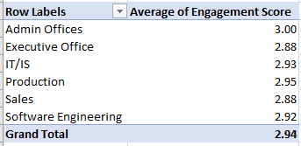
Calculate the average "Engagement Score" for each department using a pivot table.

Slide 8
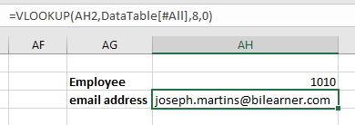
Use VLOOKUP to find the supervisor's email address for a specific employee.

Slide 9
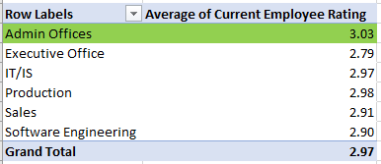
Can you identify the department with the highest average "Employee Rating?"
Admin Offices is the department with highest average Employee Rating.

Slide 10
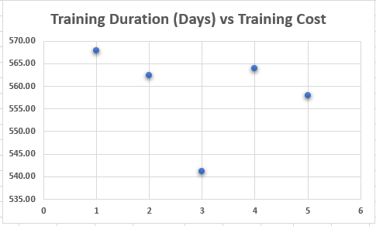
Create a scatter plot to explore the relationship between "Training Duration (Days)" and "Training Cost."

Slide 11
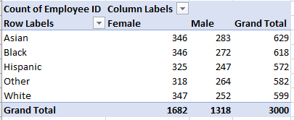
Build a pivot table that shows the count of employees by "RaceDesc" and "GenderCode."

Slide 12
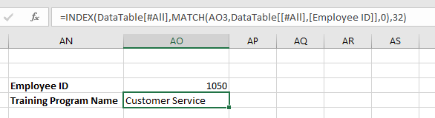
Use INDEX and MATCH functions to find the "Training Program Name" for an employee with a specific ID.

Slide 13
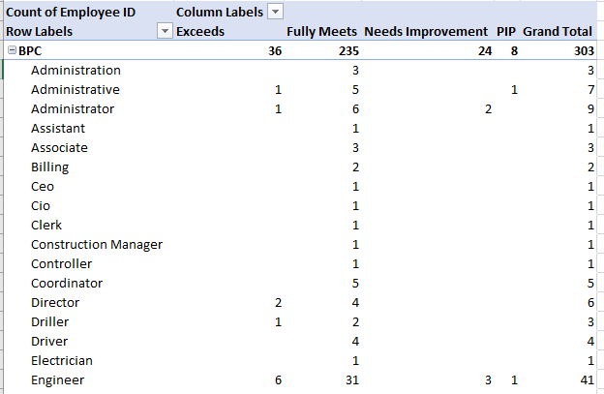
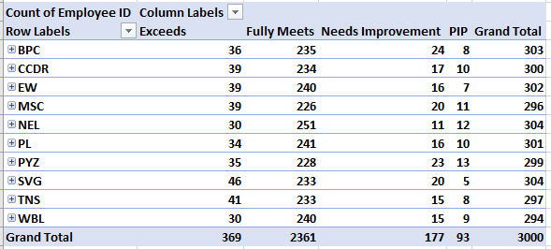
Create a multi-level pivot table to analyze the "Performance Score" by "BusinessUnit" and "JobFunctionDescription."

Slide 14
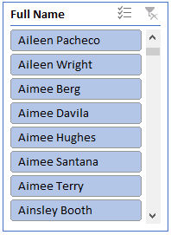
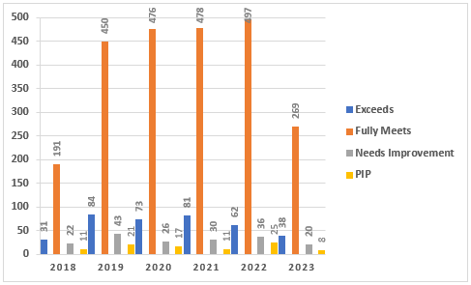
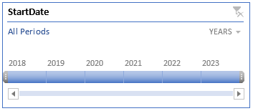
Design a dynamic chart that allows users to select and visualize the performance of any employee over time.

Slide 15
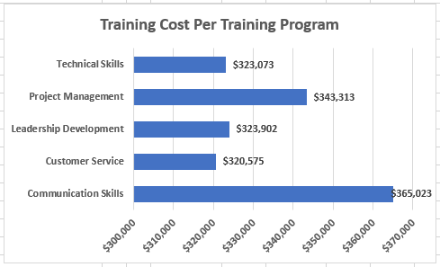
Calculate the total training cost for each "Training Program Name" and display it in a bar chart.

Slide 16
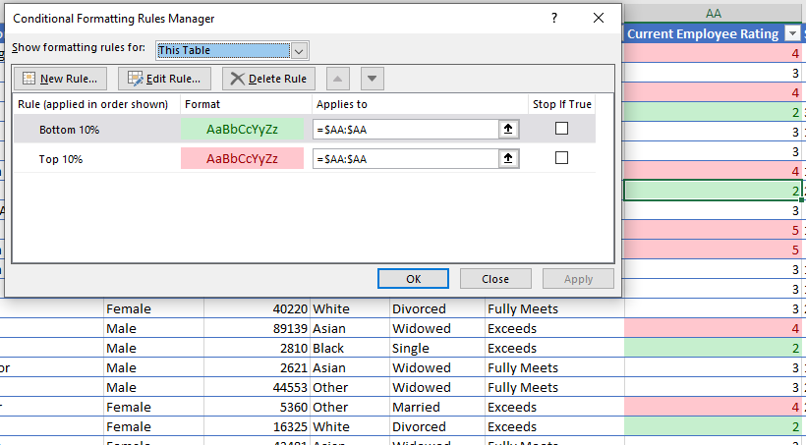
Apply advanced conditional formatting to highlight the top 10% and bottom 10% of employees based on "Current Employee Rating."

Slide 17
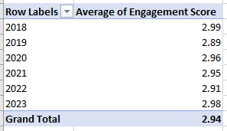
Use a calculated field in a pivot table to determine the average "Engagement Score" per year.

Slide 18
Can you build a macro that automates the process of updating and refreshing all pivot tables in the workbook?
We can create a macro by using the following methods:
Creating a Macro:
To start open the Visual Basic Editor (VBE) in Excel by pressing Alt + F11. Insert a module to hold the code.
Identifying Pivot Tables:
You can locate pivot tables by using methods such, as `ActiveWorkbook.PivotTables`. Sheets("SheetName").PivotTables`.
It might be useful to use a loop to go through all the pivot tables in the workbook.
Refreshing Pivot Tables:
Individual pivot tables by utilizing the `PivotTable.RefreshTable` method.
To refresh all pivot tables, in the workbook you can use the `ActiveWorkbook.RefreshAll` method.
Triggering the Macro:
Decide how you want to initiate execution whether through a button or shortcut key or automatically upon workbook opening or data changes.

Slide 19
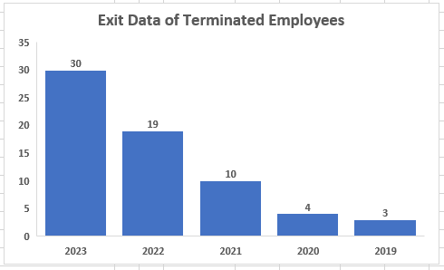
Create a histogram to understand the distribution of "ExitDate" for terminated employees.

Slide 20
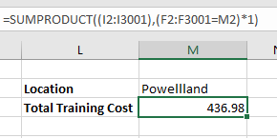
Utilize the SUMPRODUCT function to calculate the total training cost for employees in a specific location.

Slide 21
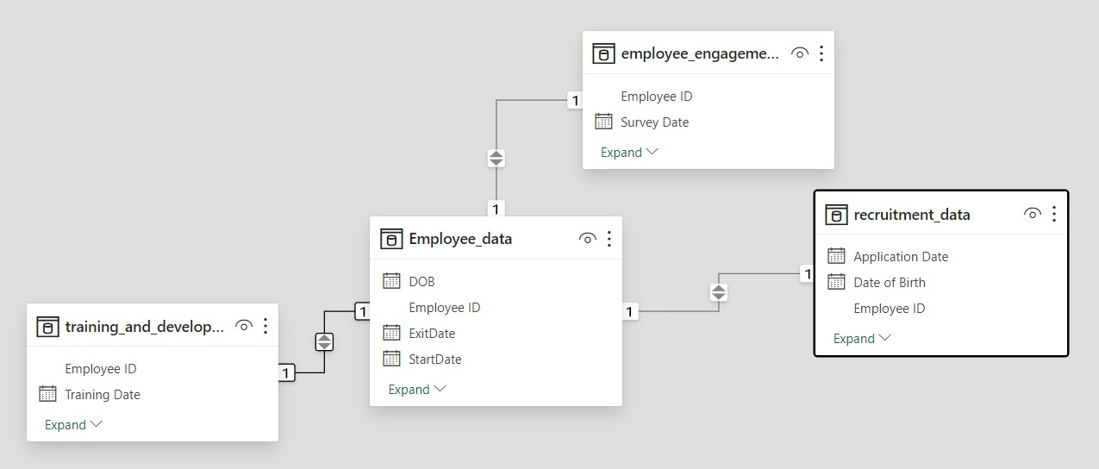
Develop a dashboard that provides an overview of key HR metrics, including headcount,performance, and training costs, using charts and pivot tables.

Slide 22
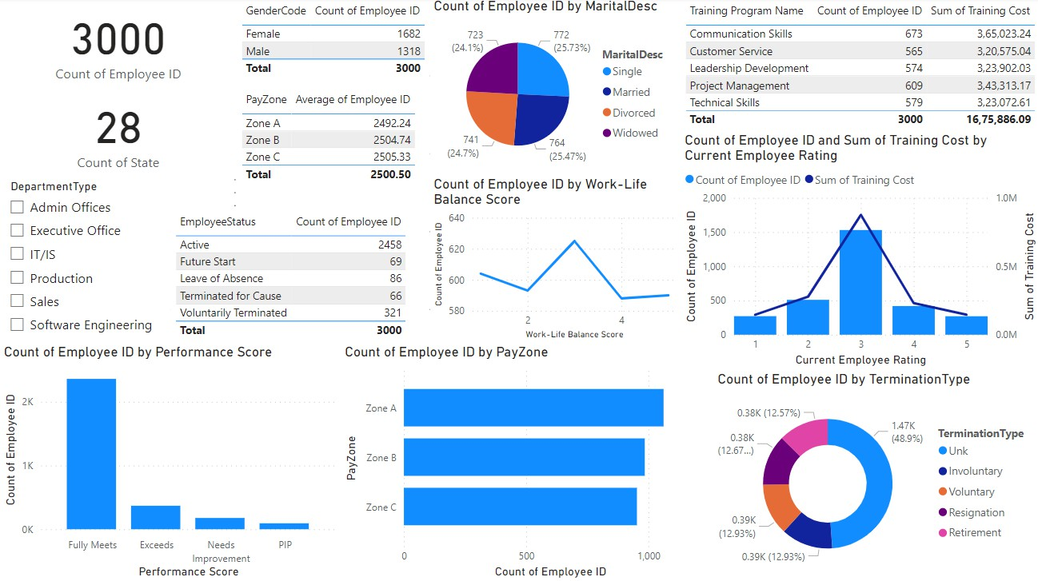
EMPLOYEE DATA DASHBOARD

